Slide 1
ENSE 470: Milestone 7
Team Dancing to Zebras
Tristan Heisler, Demitri Kourles and Zuoxiu Xing
April 12th, 2018

Slide 2
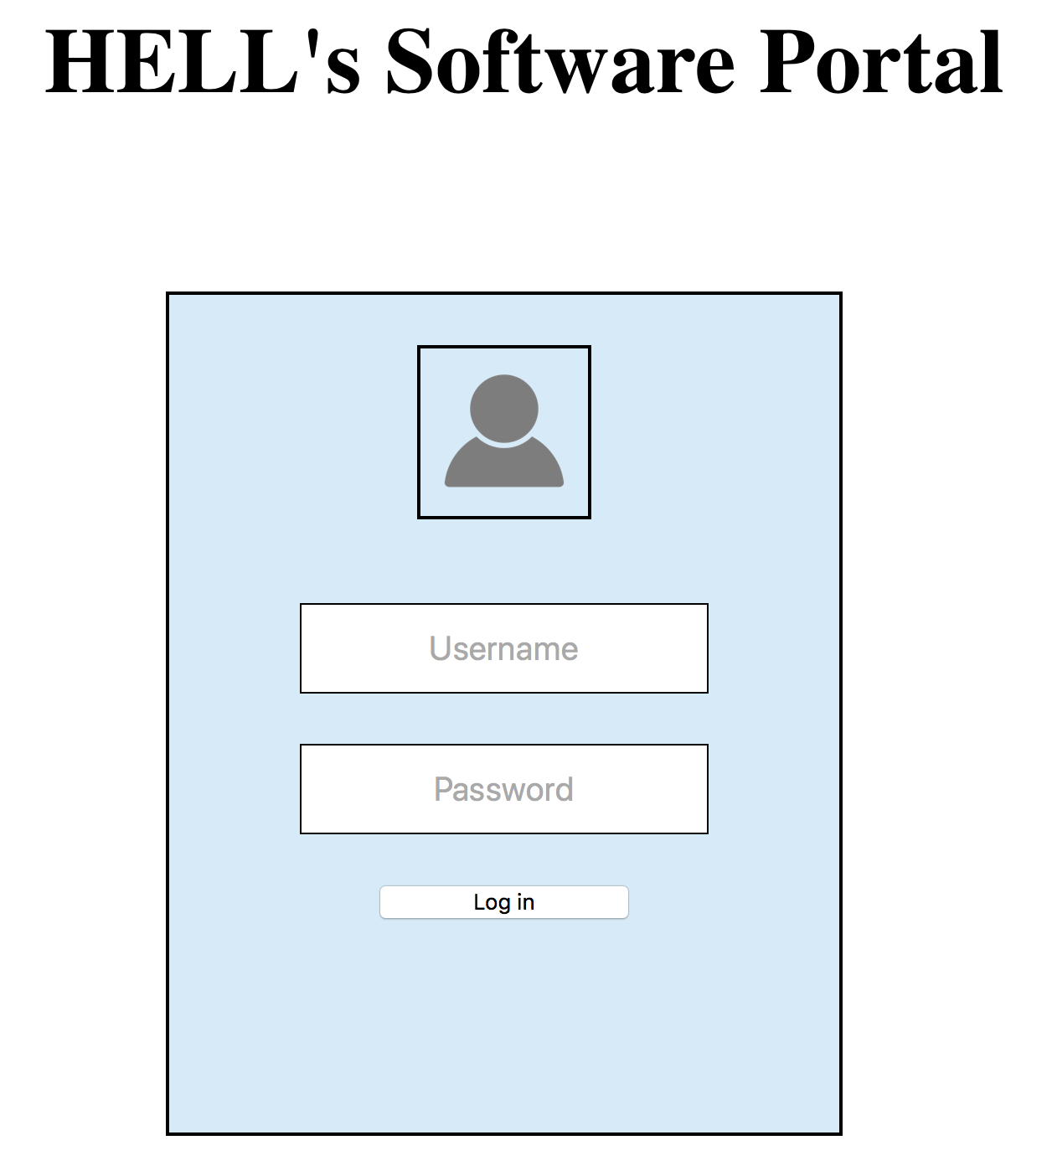
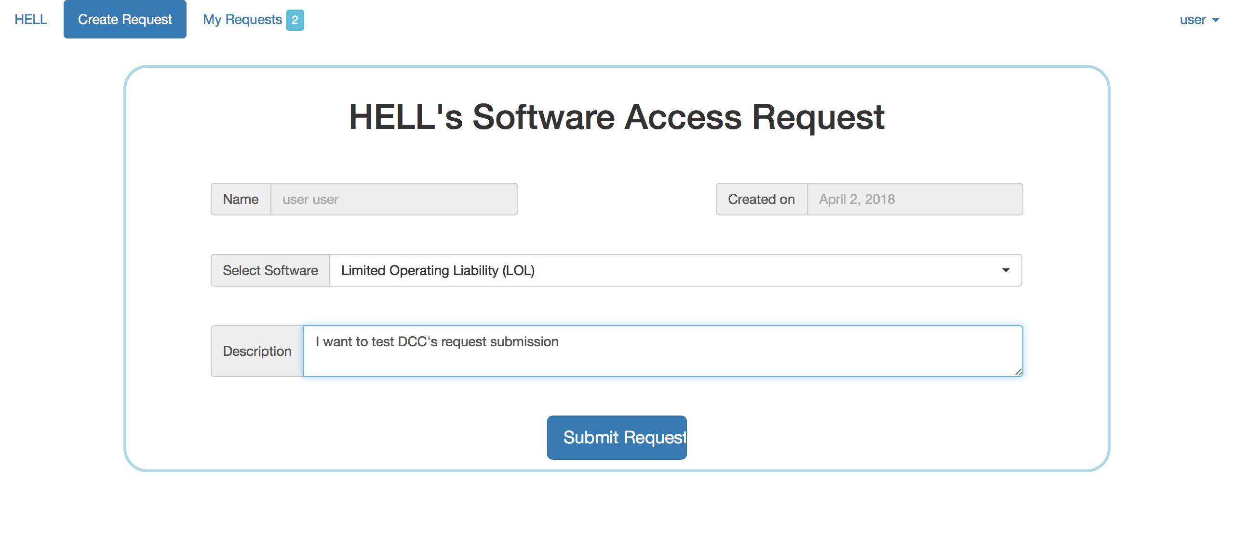
Introduction
Our group was tasked with reviewing Team DCC’s Minimum Viable Product for HELL’s Software Tool Provisioning Process.

Slide 3
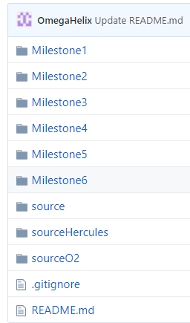
Team GitHub Review
Is the team’s GitHub readable?
We appreciate that directories have been provided for each of the previous milestones. However, these folders are missing key documents such as idea sheets, descriptive user stories and ATDD documentation.
Does the team provide good documentation?
Although progress through the project is clearly documented through the good practice of committing often, the messages associated with most commits are quite vague. We believe that more descriptive commits would improve the readability of the repository.

Slide 4
Team GitHub Review (cont.)
Is your team able to understand the file/folder names/structure (flow)?
For most folders and files, the name and structure clearly indicates their purpose.
The frontend/backend differentiation within the folder structure is not directly apparent to us. Several files that we would expect to be in the backend of the system are located in the frontend directory.
Additionally, we do not fully understand why three source folders with nearly identical code are presented.
Would your team be able to easily and quickly pick up where they left off?
We do not believe that we could easily pick up this project as a result of concerns such as duplicated directories and the lack of source documents.
Do you have any comments/guidance for the team in this area?
Our recommendation is to utilize more descriptive commit messages and attempt to improve the folder structure of the system.

Slide 5
Refactor Review
Is the team’s code obvious/readable for other programmers?
The underlying code is quite concise. There does not appear to be an abundance of unnecessary code.
However, there is a definitive lack of comments throughout the codebase. Alongside abbreviated variable names, this absence makes it more difficult to understand the purpose of each region of code.
Do all tests pass?
Unfortunately, the team’s ATDD document is not available on GitHub.
Based on the tests provided within the group’s Milestone 5 presentation, it was observed that most of the developed tests now pass.
One identified failed test is that the approvers do not have the functionality to request additional information.
Another failed test is that upon cancelling a request, a given user is prevented from ever requesting access to that tool again.

Slide 6
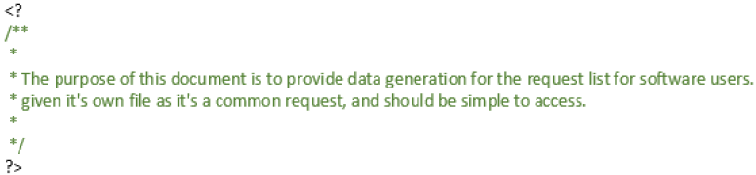
Code Smells
The main code smell identified in the provided solution is dispensables
There are files within the code base that contain nothing but a block comment.
Additionally, it was determined that several regions of the login.css page are not utilized anywhere in the website.
In order to address this problem, our refactoring recommendation is simply to remove these unnecessary files and code regions from the system. This would improve readability without changing functionality.
No other code smells were identified within the system
There are no clear indications of bloated code, abuse of object-oriented principles, unnecessary code coupling or change preventers.

Slide 7
Design Pattern Discussion
Decorator
This pattern was applied within the website’s navigation bar.
This is a great design decision, as it prevents the requirement of producing code for every possible navigation bar.
The fact that the underlying code exists in an independent file further reduces code duplication.
Notification
This pattern was applied within the buttons of the navigation bar.
We agree that this was a good design decision as it helps the user identify which portions of the website may require their immediate attention.
We would like to recommend the usage of the observer pattern. This pattern could be utilized to update the notification values presented to the user without requiring the page to be refreshed.

Slide 8
Team DCC’s Response
We would like to take this time to ask Team DCC if they have any comments or concerns with regards to our review of their system.

Slide 9
Group Reflection
How did you feel about this milestone? What did you like about it? What did you dislike?
We enjoyed having the opportunity to review the solution provided by another team. We also liked getting feedback from other individuals on our own project.
It was a challenge to understand the code developed by others without assistance.
What did you learn about yourself as you collaborated and worked through this milestone?
We learned that it is easier to review and be critical of another group’s code than your own. People may tend to have a positive bias towards their own creations.
How will you use what you have learned going forward?
We will use the experience of reviewing code and having our own code reviewed to improve our development and communication within future projects.
What “stuff & things” related to this milestone would you want help with?
It could be useful to have time set aside to meet with the group under review. While Team DCC was very cooperative, this may not always be the case.

Slide 10
Questions?

